Slide 1
Joint Research Centre
The European Commission’s in-house science service

Slide 2
GuidosToolbox Workshop
The workshop will address the following topics:
1) Introduction and motivation for new ways of pattern analysis
2) MSPA: Morphological Spatial Pattern Analysis 3) GuidosToolbox: program features and processing options 4) Hands-On examples using a training data set:
a) data preparation b) MSPA, connectivity, fragmentation, contortion, mosaic,… c) post-processing: exporting to GeoTiff, GoogleEarth overlays

Slide 3
GuidosToolbox Workshop
2) MSPA
Morphological Spatial Pattern Analysis:

Slide 4
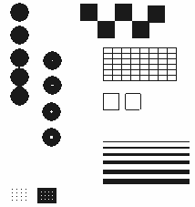
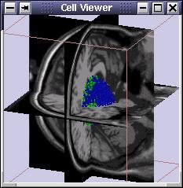
MSPA: Background
George Matheron (1930-2000): Geostatistics, Mathematical Morphology
Pierre Soille (JRC, IES-SDI)
Based on Set Theory: analyze-detect shape / structure / connectivity
Geometry
Medical Applications
Detect & analyze catchments; oil spills; vessels; mines; facial- fingerprint- character- recognition (security, fax); robotics; biology astronomy … ECOSYSTEMS !
Notes:
4
Connectivity and fragmentation can be described by analyzing the spatial pattern of the image components. We use mathematical morphology which is a scientific discipline specifically developed for this purpose by George Matheron. Pierre Soille provided further extensions and the algorithmic implementation.

Slide 5
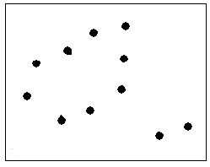
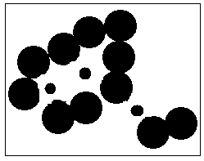
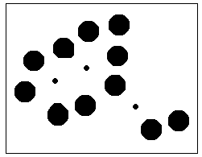
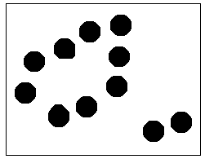
BASIC morphological filters
Structuring Element:
Erosion (shrink) →
?!
Dilation (grow) →
Morph_close = Erosion(Dilation) →
Morph_open = Dilation(Erosion) →
original

Slide 6
Segmentation steps
Implementation principle (simple 4-class scheme)
1. CORE: erosion of forest mask
2. ISLET: morphological reconstruction of forest mask: opening; dilations, difference to original forest mask
3. EDGE: forest mask - erosion = buffer zone, intersect with flood-fill from outside the image (‘wet buffer zones’)
4. PERFORATED: ‘dry buffer zones’
Notes:
6

Slide 7
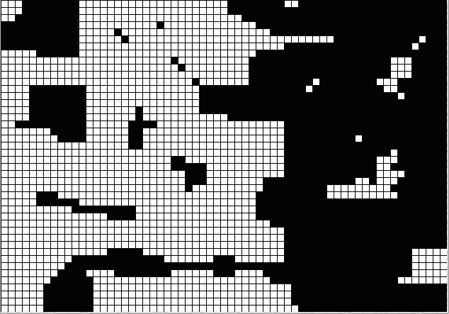
Segmentation steps
1. CORE: Step 0: starting with forest mask:
forest – black; nonforest – white
Notes:
7

Slide 8
Segmentation steps
1. CORE: Step 1: erosion (forest mask) - removed forest pixels (buffer zone)
Notes:
8

Slide 9
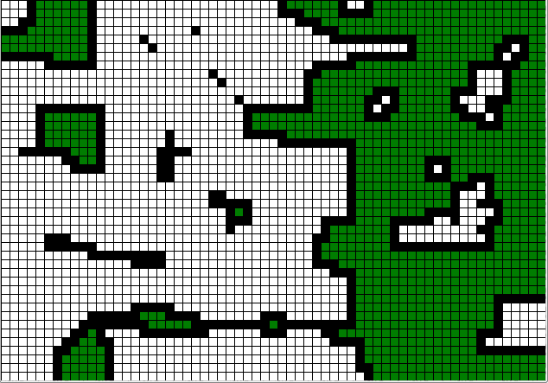
Segmentation steps
1. CORE: Result: forest mask – erosion (forest mask)
showing CORE forest pixels
Notes:
9

Slide 10
Segmentation steps
2. ISLET: Step 0: starting with forest mask:
forest – black; nonforest - white
Notes:
10

Slide 11
Segmentation steps
2. ISLET: Step 1: erosion (forest mask). Note:
- removed forest pixels, including all ISLET pixels
Notes:
11

Slide 12
Segmentation steps
2. ISLET: Step 2: dilation (Step 1) ⬄
morph_open (forest mask)
Notes:
12

Slide 13
Segmentation steps
2. ISLET: Step 3: dilation (Step 2) * forest mask
⬄ morph_reconstruction (forest mask)
Notes:
13

Slide 14
Segmentation steps
2. ISLET: Step 4: dilation (Step 3) * forest mask
⬄ morph_reconstruction (forest mask)
Notes:
14

Slide 15
Segmentation steps
2. ISLET: Step 5: dilation (Step 4) * forest mask
⬄ morph_reconstruction (forest mask)
Notes:
15

Slide 16
Segmentation steps
2. ISLET: Step 6: dilation (Step 5) * forest mask
⬄ idempotence ⬄ mask: forest – forest patch
Notes:
16

Slide 17
Segmentation steps
2. ISLET: Step 7: difference: forest mask – Step 6
Notes:
17

Slide 18
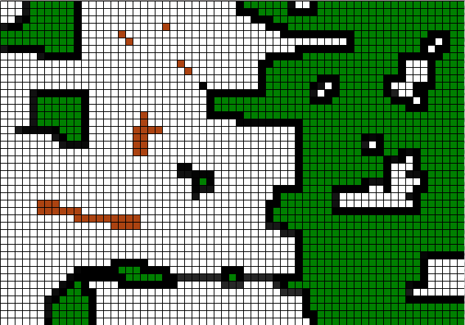
Segmentation steps
2. ISLET: Result: forest mask showing CORE + ISLET forest pixels
Notes:
18

Slide 19
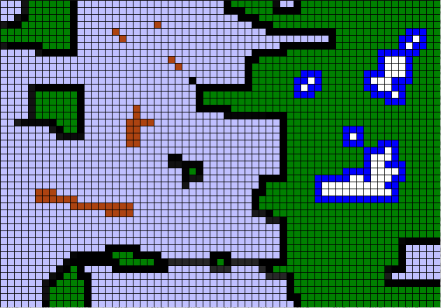
Segmentation steps
3. EDGE: flood-fill the background from outside image boundaries: EDGE: ‘wet buffer zone’ PERFORATED: ‘dry buffer zone’
Notes:
19

Slide 20
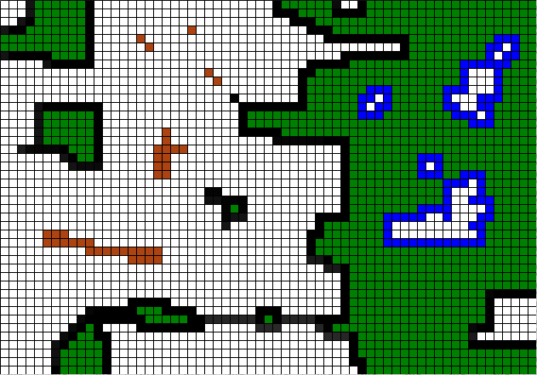
Segmentation steps
Result: CORE + ISLET + EDGE + PERFORATED forest pixels
Notes:
20

Slide 21
Segmentation steps
Official, final MSPA
i0: binary input
i1: Erosion(i0)
CORE
i2: i0 – ReconstructionByDilation(i1)
ISLET
i3: SkeletonCoreAnchor(i0)
LOOP
same Core?
yes
Connector:
no
BRIDGE
i4: (i0 – i2 – i3) ∩ Dilation(i1)
PERFORATION
i4 ∩ holes(i1)
yes
Boundary:
no
EDGE
i5: i0 – i2 – i3 – i4
BRANCH
Notes:
21

Slide 22
MSPA: homotopic, anchored skeletonization
Homotopic shrinking: skeleton of an object maintaining the information of its shape (topology)
Iwanowski & Soille, 2005: Computer Analysis of Images and Patterns, Lecture Notes in Computer Science, Volume 3691/2005, 538-545, DOI: 10.1007/11556121_66
Notes:
22

Slide 23
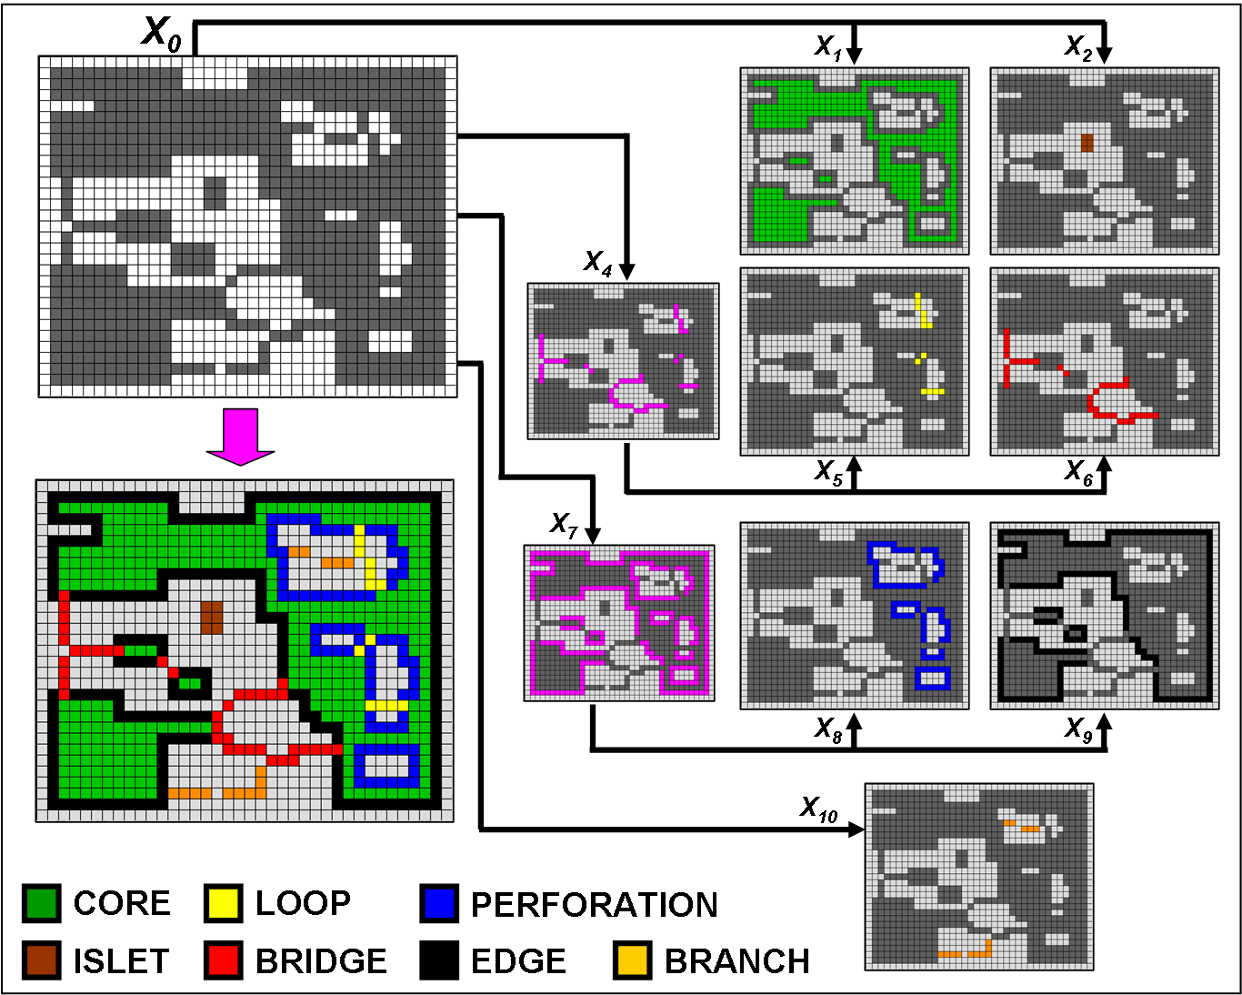
Segmentation steps
Notes:
23

Slide 24
MSPA: Segmentation
INPUT:
OUTPUT:
CORE: interior area of forest patch excluding forest perimeter
ISLET: disjoint and too small to contain Core
LOOP: connected at more than one end to the same Core patch
BRIDGE: connected at more than one end to different Core patches
PERFORATION: internal patch perimeter
EDGE: external patch perimeter
BRANCH: connected at one end to Edge, Perforation, Bridge, or Loop.
24

Slide 25
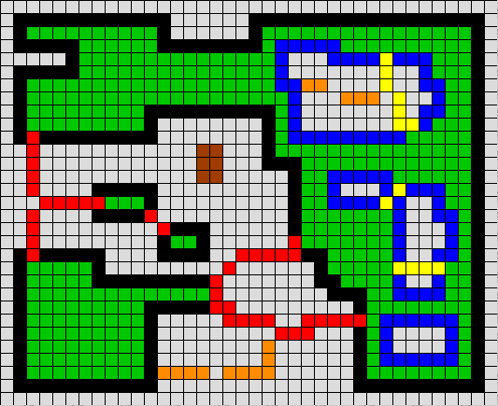
MSPA: Segmentation Features
Geometric (generic!) for any binary mask & any scale
Automated description of pattern and connectivity
The spatial detail of input and output are identical
Each pixel is in one of the mutually exclusive classes
Synthesis of object oriented and pixel based approach
MSPA
Notes:
25
Summary of the features and principle processing steps of the JRC indicator.

Slide 26
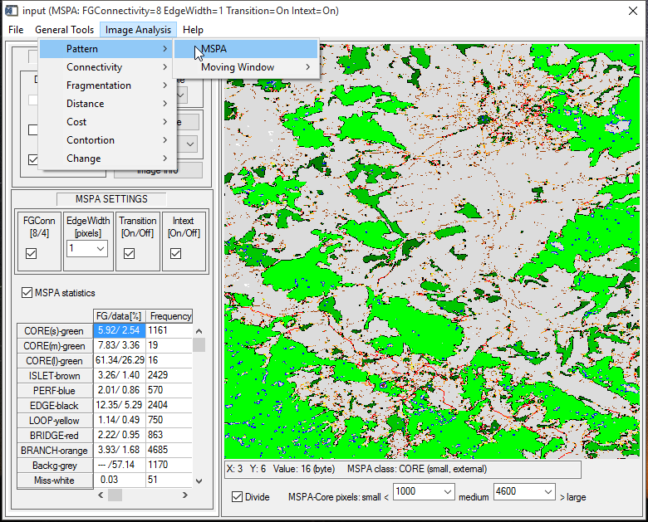
MSPA processing parameters

Slide 27
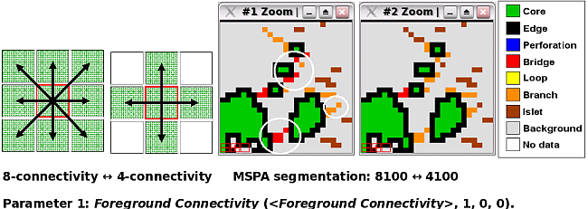
MSPA parameter 1: Foreground-Connectivity (8/4)
The white circles show the difference when using 8- (left image) or 4-connectivity (right image) for the MSPA-parameter 1: Foreground Connectivity.

Slide 28
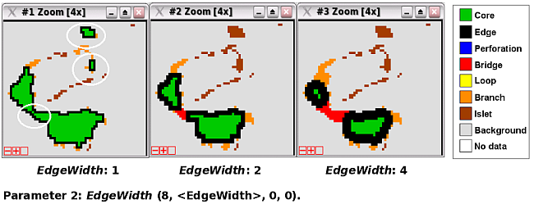
MSPA parameter 2: EdgeWidth (1-100)
EdgeWidth increase reduces non-core area at the expense of
core-area and may change the pattern classes (white circles). EdgeWidth changes do not affect total foreground coverage.

Slide 29
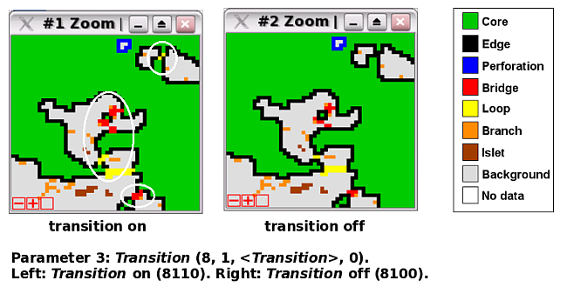
MSPA parameter 3: Transition (1/0 – on/off)
Transition: set to show connecting transition pixels to Core
area (white circles) or hide these pixels to maintain closed
perimeters for the classes perforation and edge.

Slide 30
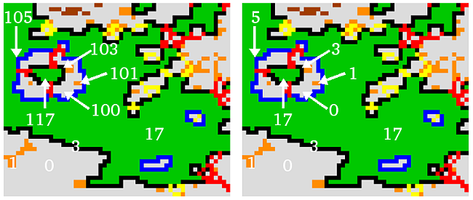
MSPA parameter 4: Intext (1/0 – on/off)
Intext=1
Intext=0
Intext can be used to add a second layer of the 7 basic classes
inside perforations. When Intext is on (1) a pixel offset of 100 is added to the feature classes in the internal areas of the foreground objects.

Slide 31
GuidosToolbox: Help → MSPA Guide
MSPA input data
Single channel, (Pseudo-) binary raster data having maximum 3 values:
0 byte – Missing (optional)
1 byte – Background (mandatory)
2 byte – Foreground (mandatory)
Format: 8bit Tiff (GeoTiff), generic image formats
additional files (.hdr, .tfw, etc) are not needed; Compression: none or LZW

Slide 32
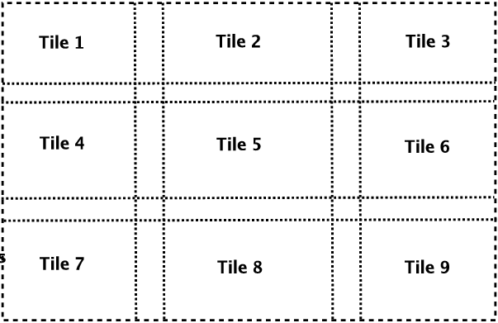
GuidosToolbox: Help → MSPA Guide
MSPA input data
Maximum. size/dimension: MS-Windows: 100 MB (10k²) Mac/Linux: 4,8,16,32,128 GB RAM: 12k², 18k², 28k², 40k², 75k² GuidosToolbox: 30k². Larger images must be processed using MSPA-Tiling: automatic procedure of buffered tiling, MSPA- processing, appropriate reassembling of final result (GeoTiff only!). Or use the MSPA cmdline version outside of GTB.

Slide 33
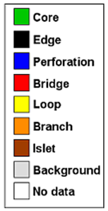
GuidosToolbox: Help → MSPA Guide
MSPA output data
Binary raster data (GeoTiff, Tiff, LZW-compressed)
A) Visual result: maximum of 9 colors: - 7 pattern classes of Foreground, - White – Missing (optional), - Gray – Background (mandatory).
Note:
MSPA class names are generic. Their meaning depends on
the nature of the input data and should be amended by the
user. E.g., Perforation, the outer perimeter of a Foreground
'hole' in a forest mask could be a 'clearing' while for a water
mask such an area is an 'island'.

Slide 34
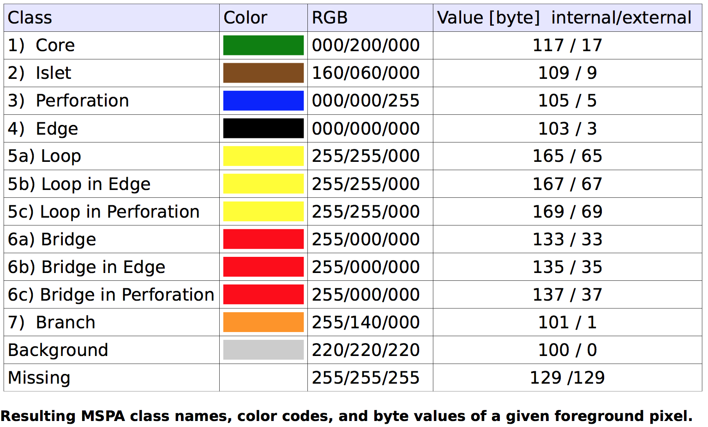
GuidosToolbox: Help → MSPA Guide
B) Numeric result: maximum number of unique byte values: - 13 (11-Foreground + 1-Missing + 1-Background), Intext=0 - 24 (21-Foreground + 1-Missing + 2-Background), Intext=1
Colors shown for Transition = 1. If Transition = 0 then 5b, 6b → black (4); 5c,6c → blue (3)

